Slide 1
Nuclear Safety and Emergency Preparedness
Notes:
1

Slide 2
TOPICS:
SCOPE
General plant data
Nuclear Safety
Emergency Preparedness
Conclusions

Slide 3
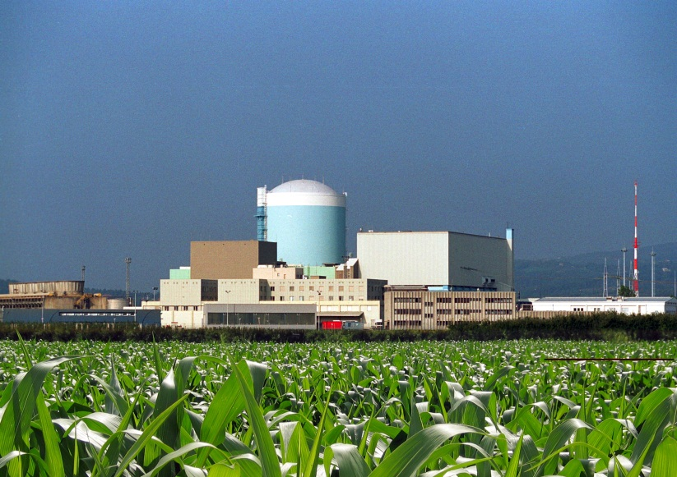
Nuclear Power Plant Krško in brief
NUCLEAR SAFETY AND EMERGENCY PREPAREDNESS
General Plant Data
0wner…………………….. GEN Energija- 50%
HEP -50%
Operator ………………… Nuklearna elektrarna Krško
NSSS supplier…………... Westinghouse
Reactor type……………. PWR
Construction permit…… 1975
Commercial operation… 1983
Operating license………. 40 years
Number of employees…. ~600
Gross plant output………. 727 MW
more:
http://www.nek.si/en/about_nuclear_technology/technical_data
Notes:
3

Slide 4
Independent functions ensured
NUCLEAR SAFETY AND EMERGENCY PREPAREDNESS
General Plant Data - organization
Plant Governance
Nuclear Safety Oversight
Bilateral
committee
4 + 4
Administration for Nuclear Safety
The Ministry of the
Environment and
Spatial Planning
HEP Electric
50 %
GEN-Energija
50 %
Krško Safety Committee KSC
Assembly
1 + 1
IAEA
WANO
EU-WENRA
NEK d.o.o. Management Board
1 + 1
Supervisory
Board
3 + 3
Notes:
4

Slide 5

Bilateral agreement between Slovenia and Croatia
Agreement between Slovenia an Croatia on the regulation of the status and other legal relationships relating to investments in the Krško Nuclear Power Plant, its use and decommissioning (valid since march 11th 2003) determines :
ownership and capital,
delivery of electricity
company governance,
the price and production costs,
employment and training,
contractors,
dismantling, radioactive waste
financing of dismantling and disposal
NUCLEAR SAFETY AND EMERGENCY PREPAREDNESS
General Plant Data - ownership
50%:50%
partnership
Notes:
5

Slide 6
Business concept in NPP Krško
NUCLEAR SAFETY AND EMERGENCY PREPAREDNESS
General Plant Data - vision
"To efficiently and consistently produce the electricity for the customers on safe, competitive and environmentally acceptable way."
safe
SUSTEINABILITY
competitive
acceptable
Our goal
The NEK will be ranked in the first quarter of the world nuclear operators based on standard performance indicators of nuclear safety, stability of operation, and economic efficiency
Notes:
6

Slide 7
Improving production trend in NPP Krško
NUCLEAR SAFETY AND EMERGENCY PREPAREDNESS
General Plant Data - production
NEK Goal for 2012 > 5,31 TWh
Cumulative : 139,12 TWh
3-year average:5,6 TWh
Notes:
7

Slide 8
Operations results after investment in last 10+ years
NUCLEAR SAFETY AND EMERGENCY PREPAREDNESS
General Plant Data - investments
Power uprates:
2000 - SG replacement and power uprate 664 MW
2006 – LP Turbine and HP heaters replacement 707 MW
2007 – MSR and LP heaters replacement 727 MW
????? – HP turbine replacement 734 MW
Increased plant reliability:
Cooling towers extension
18m fuel cycle
Optimization and duration of outages
Preventive replacement of equipment
Improvements in plant processes
4,5 TWh/year 5,6 TWh/year
Difference is 1,1 TWh/yr, this is app. 8 HPP on Sava river!

Slide 9
Nuclear safety a top priority-defense in depth
NUCLEAR SAFETY AND EMERGENCY PREPAREDNESS
Nuclear Safety
Nuclear safety is a universal requirement and is a top priority for NEK as operating organization. To achieve nuclear safety, means to ensure the protection of people and the environment against radiation risks by achieving the highest practical safety level of nuclear reactor. Defense in depth is implemented by the combination of independent levels of protection.
safety culture
oversight and regulation
Defence in depth
design
High quality
appropriate site
safety assessment
operation practices
Comprehensive testing
Notes:
Prevention of failures, 2. Detection and control of failures, 3. Control of design bases accidents, 4. Control of severe accidents, 5. Emergency plans.
Close attention to human performance and operational practices and management systems that that include periodic safety assessment and that foster a strong safety culture throughout the operating organization
9

Slide 10
Focus on operational factors of nuclear safety
safety culture, an effective management system and strong commitment to safety
ongoing sound operational practices complemented by self assessment, independent oversight, and international peer reviews
systematic approach to training and professional development of employees and supporting organizations
effective use of operating experience and lessons learned from event analysis
Continuous risk analysis and risk management as a part of operational activities
comprehensive maintenance program and IN-service inspection to address ageing phenomena
international benchmarking through safety organizations like WANO,INPO, IAEA, operating utilities…
10-year periodic safety reviews, improvement of safety systems
NUCLEAR SAFETY AND EMERGENCY PREPAREDNESS
Nuclear Safety
Notes:
10

Slide 11
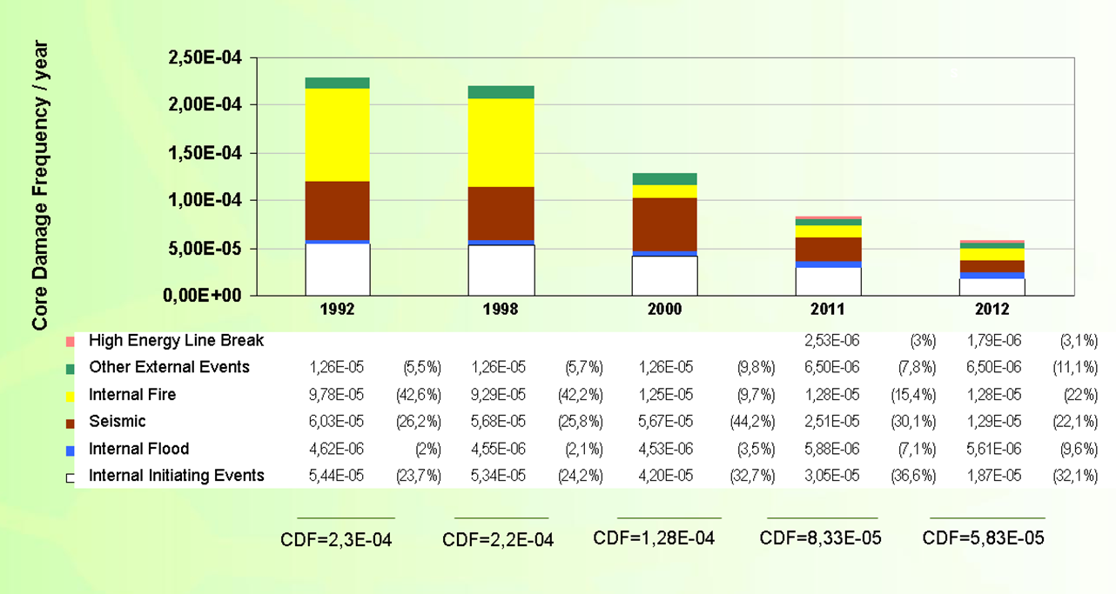
Comparison of contributors to core damage frequency (CDF)
NUCLEAR SAFETY AND EMERGENCY PREPAREDNESS
Nuclear Safety - CDF
CDF= Core Damage Frequency
IE=Initiating Event
Notes:
11

Slide 12
NEK response on B.5.b
NUCLEAR SAFETY AND EMERGENCY PREPAREDNESS
Nuclear Safety – recent terrorist and industry events
After the terrorist attack in the USA (11/9), NRC issued B.5.b measures and requirements for all NPPs; the B.5.b required to:
Purchase and ensure equipment and personnel to manage serious fires and
Purchase and ensure mobile equipment for:
Core cooling and Containment cooling,
Spent Fuel Pit (SFP) cooling.
In such manner the emergency such as a commercial aircraft crash on the plant can be managed.
The SNSA issued a decision (2009), requiring from the plant to prepare an analysis regarding an impact of aircraft crash on the plant,
Krško NPP prepared an action plan with a target completion date in 2012.
As a lessons learned from Fukushima accident, the Krško plant decided to expedite implementation of actions most of which were resolved up to 30 June 2011.
Notes:
12

Slide 13
NEK response on Fukushima and Stress tests
NUCLEAR SAFETY AND EMERGENCY PREPAREDNESS
Nuclear Safety – recent terrorist and industry events
In March 2011 an accident occurred at Japanese NPPs in Fukushima.
In addition to earthquake (M9) and tsunami (waves of appr. 15 m high), nuclear accident occurred. It was caused by the loss of all offsite (earthquake) and onsite power supply (the flood destroyed the seawater cooling pumps and Emergency Diesel Generators - DGs).
Loss of core cooling and SFP cooling caused core melt and release of radioactive material from the SFP.
Main causes of the nuclear disaster: earthquake + flood (tsunami) + loss of onsite and offsite power supply + understaffed plant + failure to obtain external support in a few days
Notes:
13

Slide 14
NEK Safety Upgrade Program NEK response on B.5.b Fukushima and Stress tests
NUCLEAR SAFETY AND EMERGENCY PREPAREDNESS
Nuclear Safety – recent terrorist and industry events
Until end of June 2011, the Krško plant carried out as follows:
Purchase additional mobile equipment (mobile Diesel Generator – DG, pumps etc.);
Perform modifications enabling additional equipment to be connected to existing Krško plant systems (fast connections).
At the end of May 2011, European Nuclear Safety Regulator Group (ENSREG) and European Commission (EC) agreed on the technical scope of „Stress Tests“.
In Slovenia, Special Safety Review was required on the basis of Ionising Radiation Protection and Nuclear Safety Act (ZVISJV, Article 48).
Notes:
14

Slide 15
NEK Safety Upgrade Program NEK response on B.5.b Fukushima and Stress tests
NUCLEAR SAFETY AND EMERGENCY PREPAREDNESS
Nuclear Safety – recent terrorist and industry events
In response to the Fukushima accident, the SNSA in its decision of 30 May 2011 imposed the so called „stress tests“ on Krško NPP in compliance with ENSREG specification (Special Safety Review):
Intermediate Report to be completed by 15 August 2011;
Final Report to be completed by 30 October 2011;
The final stress test progress report was sent to the SNSA for review; the report was then the subject of international review (ENSREG & EC).
Notes:
15

Slide 16
NEK Safety Upgrade Program NEK response on B.5.b Fukushima and Stress tests
NUCLEAR SAFETY AND EMERGENCY PREPAREDNESS
Nuclear Safety – recent terrorist and industry events
Within the frame of PSR 1 Program, the Krško plant carried out numerous actions and modifications which are important from the view of extreme offsite events, including:
Additional onsite power supply – 3rd independent DG (project start in 2008)
Rising the flood protection dykes of the Sava River – upgrading the existing flood protection of the plant – result of Possible Maximum Flood (PMF) Study made in compliance with a new standard (studies made during 2006–2009; start of rising the dykes in 2010)
Notes:
16

Slide 17
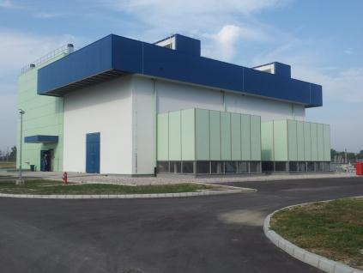
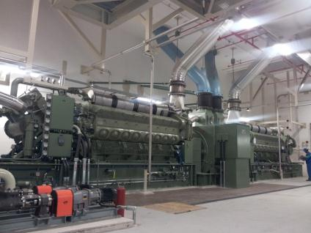
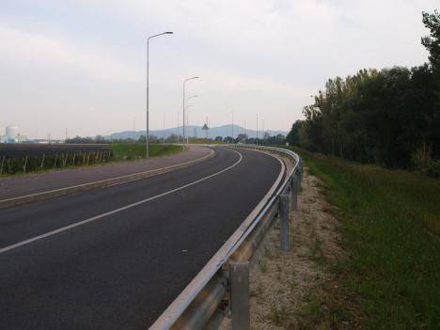
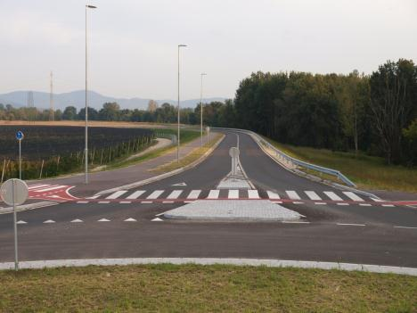
NEK Safety Upgrade Program NEK response on B.5.b Fukushima and Stress tests
NUCLEAR SAFETY AND EMERGENCY PREPAREDNESS
Nuclear Safety – recent terrorist and industry events
Notes:
17

Slide 18
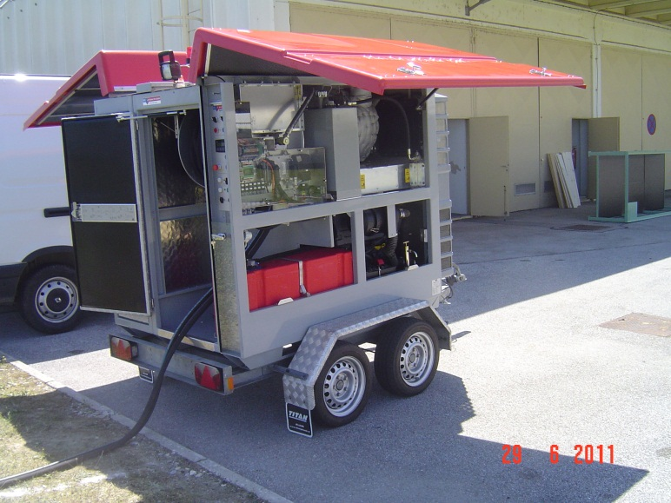
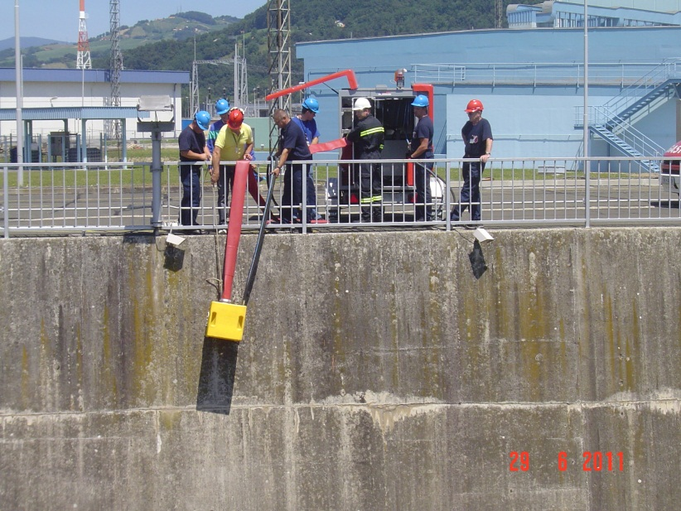
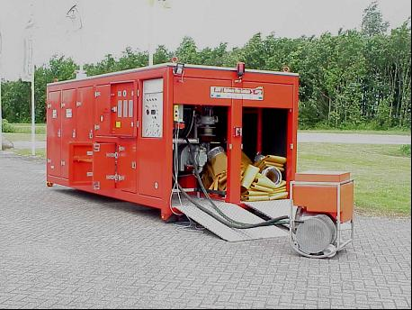
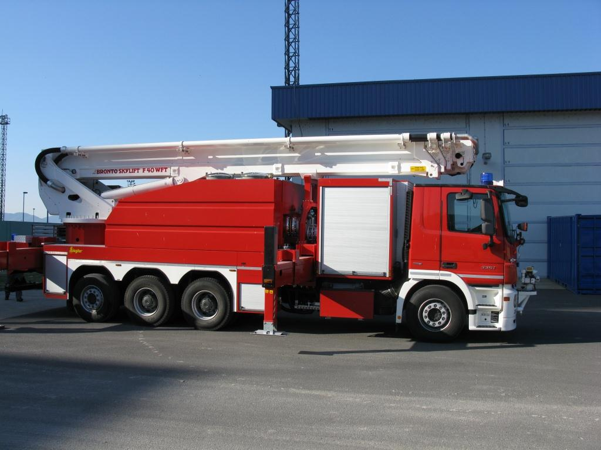
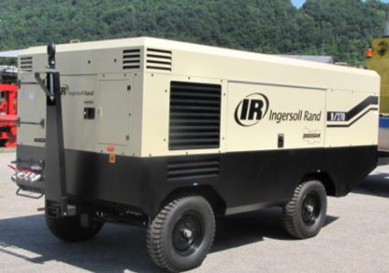
Mobile equipment: pumping stations, vehicles, Instrument Air (IA) compressors
NUCLEAR SAFETY AND EMERGENCY PREPAREDNESS
Nuclear Safety – recent terrorist and industry events
Notes:
18

Slide 19
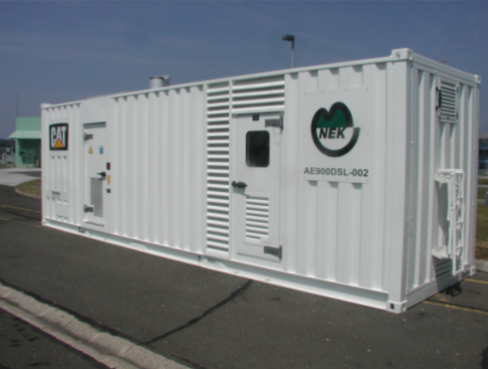
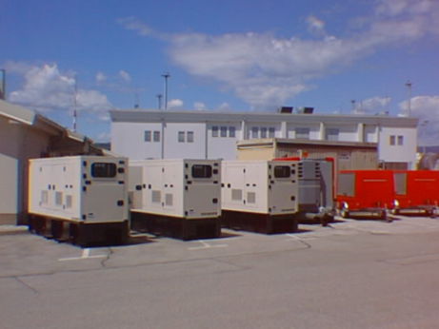
Mobile equipment: power supply sources
NUCLEAR SAFETY AND EMERGENCY PREPAREDNESS
Nuclear Safety – recent terrorist and industry events
Notes:
19

Slide 20
NEK Safety Upgrade Program NEK response on B.5.b Fukushima and Stress tests
NUCLEAR SAFETY AND EMERGENCY PREPAREDNESS
Nuclear Safety – recent terrorist and industry events
NEK performed plant response analysis, external/natural event margins which lead to „cliff edge“ effect (fuel damage) on several areas:
Earthquake,
Flooding,
Extreme weather conditions,
Loss of all offsite and onsite power supply,
Loss of access to Ultimate Heat Sink (UHS),
Severe Accident Management System – core melt (organization, procedures, equipment etc.).
Notes:
20

Slide 21
NEK Safety Upgrade Program NEK response on B.5.b Fukushima and Stress tests
NUCLEAR SAFETY AND EMERGENCY PREPAREDNESS
Nuclear Safety – recent terrorist and industry events
During Special Safety Review (i.e. stress tests) the SNSA at the beginning of September 2011 and prior to the decision of the PLEX required from the plant to carry out analyses, complete them by 15 January 2012 and prepare the Safety Upgrade Program (SUP) of the Krško NPP to be reviewed an approved by the SNSA.
In accordance with the requirement, the Krško NPP submitted SUP to the SNSA together with the expert opinion of the authorized institution.
The SNSA approved SUP in February 2012
The SUP consists of the following modifications that will be implemented from 2012-2016:
Safety Upgrade – injection into RCS & CI (SU-SI/CI)
Safety Upgrade – injection into SG (SU-AF)
Safety Upgrade – additional Ultimate Heat Sink (SU-AUHS)
Safety Upgrade – containment integrity – pressure & hydrogen control (SU-CFVS)
Safety Upgrade – Emergency Control Room (SE-ECR)
Safety Upgrade – Spent Fuel Pit cooling
Safety Upgrade – Technical Support Centre upgrade & flood protection of objects
Safety Upgrade – improvement of AC/DC supply sources
Notes:
21

Slide 22
Emergency Classification
NUCLEAR SAFETY AND EMERGENCY PREPAREDNESS
Emergency Preparedness
EMERGENCIES ARE CLASSIFIED IN FOUR LEVELS ACCORDANCE TO THE POSSIBLE RADIOLOGICAL CONSEQUENCES ON-SITE AND OFF-SITE:
0. LEVEL OF EMERGENCY OR UNUSUAL EVENT,
I. LEVEL OF EMERGENCY OR ALERT,
II. LEVEL OF EMERGENCY OR SITE EMERGENCY,
III. LEVEL OF EMERGENCY OR GENERAL EMERGENCY.
CLASSIFICATION BASED ON NUREG 654 - 82 GENERAL CLASSIFICATION CRITERIA (SITE SPECIFIC EMERGENCY ACTION LEVELS) WICH CONSIDER:
- LEVEL OF RADIOACITVITY RELEASE,
- CORE DAMAGE STATUS,
- ANOMALIES AND FAILURES IN TECHNICAL PROCESS,
- POWER SUPPLY PROBLEMS,
- FIRE,
- NATURAL EVENTS:
(EARTHQUAKE, FLOOD, LOW WATER, TUNDERSTORM);
- EXTERNAL EVENTS:
(AIRCRAFT CRASH, NEARBY TRANSPORT ACCIDENT OR RELEASE OF DANGER MATERIALS, SITE OR NEARBY EXPLOSION);
- PERSON INJURY WITH IRRADIATION OR CONTAMINATION,
- SECURITY EVENTS.

Slide 23
NUCLEAR SAFETY AND EMERGENCY PREPAREDNESS
Emergency Preparedness
EXTEND OF ACTIVATION DEPENDS OF EMERGENCY LEVEL
UNUSUAL EVENT
ALERT
SITE / GENERAL EMERGENCY
EMERGENCY OPERATIONS
FACILITY(EOF)
TECHNICAL SUPPORT
CENTRE (TSC)
MCR +
SHIFT ORGANIZATION
AUXILIARY LOCATIONS
Security center
On-site ambulante
Laboratories
Control point rooms
Fire fighter’s rooms
OPERATIONAL SUPPORT
CENTRE (OSC)
OFF-SITE SUPPORT ORGANIZATIONS
(professional fire brigade, local and national medical center, ELME* and ZVD mobile units, Westinghouse)
*ELME - Ekološki Laboratorij Mobilne Enote (IJS)

Slide 24
NUCLEAR SAFETY AND EMERGENCY PREPAREDNESS
Emergency Preparedness
EMERGENCY PLANNING LEVELS
STATE
(URSZR - coordinator)
(Uprava RS za zaščito in reševanje)
REGIONAL
(URSZR – exp. Brežice)
LOCAL
(municipalities Krško,Brežice, Kostanjevica)
SITE
(NPP Krško)
EMERGENCY PLANNING ZONES (EPZ)
SITE PROTECTED AREA AND EXCLUSION AREA (500m)
PRECAUTIONARY ACTIONS EPZ (OPU - Območje preventivnih ukrepov)
3 km around NPP – extend over 6 local communities (cca 9 000 inhabitants)
URGENT PROTECTIVE MEASURES EPZ (OTU - Območje takojšnjih ukrepov)
10 km around NPP – extend over 30 local communities (cca 36 000 inhabitants)
LONG TERM PROTECTIVE MEASURES EPZ (ODU - Območje dolgoročnih ukrepov)
Extend 25 km around NPP – 14 municipalities (cca.90 000 inhabitans in SLO and cca 70 000 inhabitans in CRO)
GENERAL EMERGENCY PREPAREDNESS (Območje splošne pripravljenosti)
R Slovenia

Slide 25
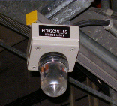
NUCLEAR SAFETY AND EMERGENCY PREPAREDNESS
Emergency Preparedness
Notification Scheme in case of Event:
By NOTIFICATION FORM in 15 (30) minutes with fax or radio communications
Local notification centre (ReCO Brežice)
National notification centre (CORS - Center obveščanja R Slovenije)
SNSA
NPP Krško
MCR
TSC
EOF
NPP’s intervention personnel
ON-site notifications
By automatic notification system (ANS)
By on-site notification system
NPP support organizations
Media
By public information in 2 hours
By ANS* or telephone communications
*Automatic notification system (ANS)

Slide 26
Upgrades in Emergency Preparedness after Fokushima event
NUCLEAR SAFETY AND EMERGENCY PREPAREDNESS
Emergency Preparedness
After Fokushima nuclear accident and completion of stress test, major Emergency Preparedness changes were required in MULTI-UNIT NPP! NEK is single unit NPP!
NEK already performed several improvements in the area of communication and notification (satellite telephoned for example), several improvements will be done within SUP
NEK is implementing SUP which intend to build new TSC, reconstruct OSC and will improve organization of the plant emergency preparedness
Compatible notification system with EU (borders France, Germany, Belgium): NPP inform state organs. The state notify neighboring countries in case of emergency.

Slide 27
Objectives for the future
NUCLEAR SAFETY AND EMERGENCY PREPAREDNESS
Conclusions
Improved performance: availability 93%, automatic scrams 0, forced loss rate ≤1%, Outage duration 25days/18month,collective radiation exposure <0.5 man Sv/year
Investment of € 300-400 million in the next 10 years to increase nuclear safety, improve material condition, reduce environmental impact
Periodic safety review each 10 years, implementation of recommendations
Plant life extension to 40+10+10 years, manage change of generation
Effective on site waste management solutions for LILW and spent fuel

